Slide 1
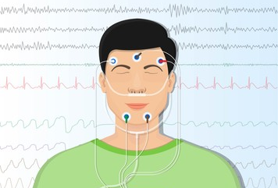
Neural ODE for Sleeping Stage Identification
Itamar Meyer Orel Tsioni
Supervisor: Ms. Ya-Wei Lin

Slide 2
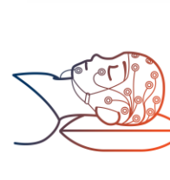
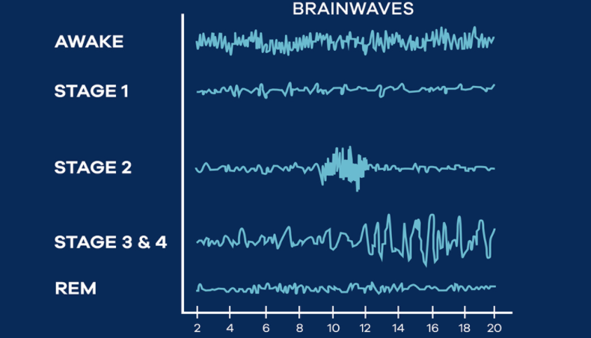
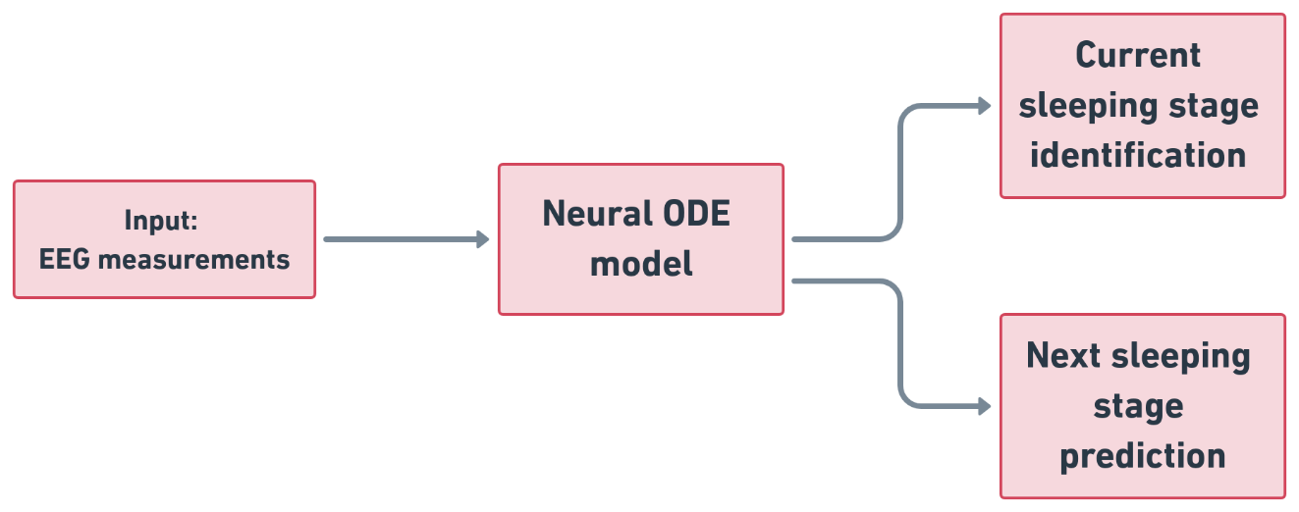
Main goal
Main purpose - Feed data to the model and see the performance of our model in classifying sleeping stages.
The data is a time series of EEG measurements during people sleeping time.
Neural ODEs are neural network models which generalize standard layer to layer propagation to continuous depth models.
Sleeping stage classification
Notes:
Our model is a neural ODE network. Which is based on the paper by Chen et al.
it is a type of neural network that uses ODE solver function, which is a black box function, that does forward pass as in other NNs.
Our data is sleeping EEG recording which consists of 75 subject brain activity recordings.

Slide 3

Agenda
Introduction to Neural Ordinary Differential Equations
ResNet
ResNet and Euler method
From ResNet to Neural Ordinary Differential Equations
Modeling Rates of Change
Neural ODE Loss and Forward Pass
Adjoint Sensitivity Method
Training and Backward Pass
Benefits and paper results
The Data
The Model
Training and tuning the hyper parameters
Results
Raw data
Feature engineering
Band pass over 75 test subjects
Ablation study – Drop single band
Ablation study – keep single band
Inter subjects training and testing
Frequency domain
Future work

Slide 4
Neural Ordinary Differential Equations
Neural ODE – One of the best paper awards in NeuralPS 2018
What does it contain?
Description of ANN using ODE solver
A backpropogation algorithm for ODE solver
Generative process
Continues normalized flow
arXiv:1806.07366 , Chen et al.
Note: Red is not covered up with this presentation
Notes:
NeuralIPS stands for “conference on Neural Information Processing Systems”. Is an international machine learning and computational neuroscience conference held every year.

Slide 5
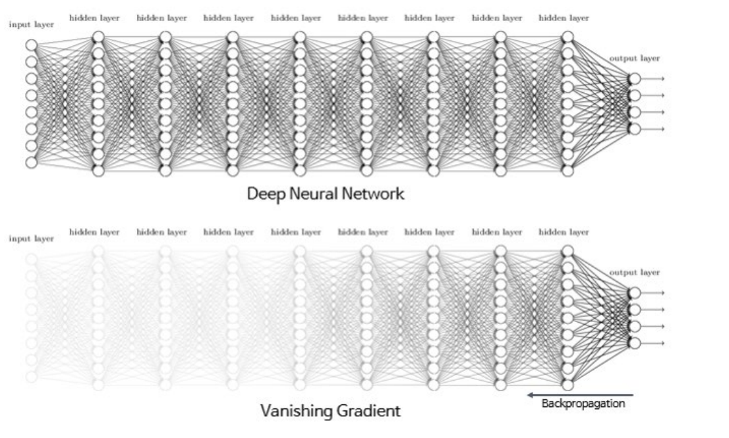
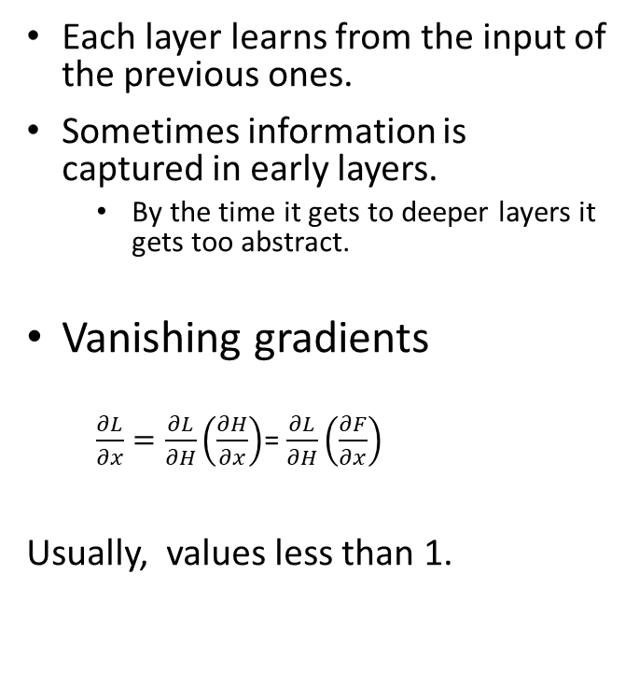
Deep Neural networks
Each layer learns from the input of the previous ones.
Sometimes information is captured in early layers.
By the time it gets to deeper layers it gets too abstract.
Vanishing gradients
$\frac{∂L}{∂x}=\frac{∂L}{∂H}\left(\frac{∂H}{∂x}\right)$= $\frac{∂L}{∂H}\left(\frac{∂F}{∂x}\right)$
Usually, values less than 1.
Notes:
We will start from the very basic, which will give the reason for the existence of Neural ODE.
Evidence show that deeper convolutional NNs allow models to become richer and more expressive, thus enabling them to approximate a bigger family of elaborated functions.
With that, one can not simply add infinite number of layers to his network, because it causes 2 major issues: vanishing gradients and accuracy saturation.
Very briefly
Vanishing gradient is the problem that occurs when the back propagation of the gradients gets too small to change the parameters in the early layers of the model.
Accuracy saturation is a problem where the model learns most of it’s attributes in the early layers, and the rest of the layers actually decrease it’s performance in the task, which makes them useless.

Slide 6
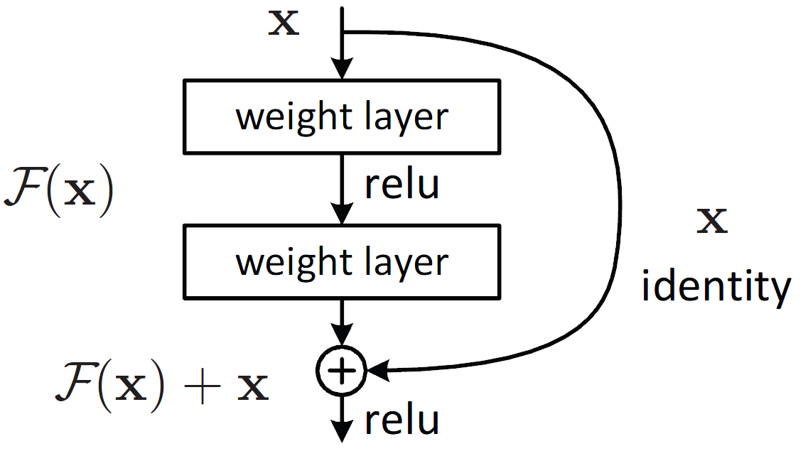
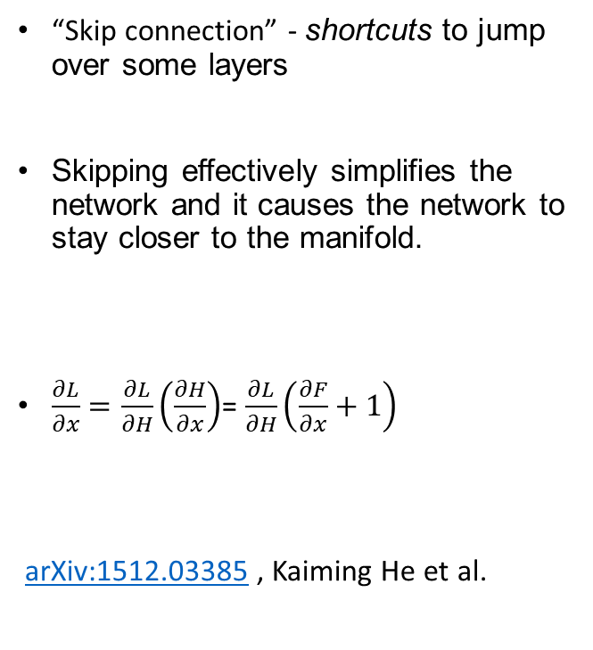
ResNet – Deep residual learning for image recognition
“Skip connection” - shortcuts to jump over some layers
Skipping effectively simplifies the network and it causes the network to stay closer to the manifold.
$\frac{∂L}{∂x}=\frac{∂L}{∂H}\left(\frac{∂H}{∂x}\right)$= $\frac{∂L}{∂H}\left(\frac{∂F}{∂x}+1\right)$
arXiv:1512.03385 , Kaiming He et al.
$${ResNet: h}_{t+1}=h_{t}+f\left(h_{t},θ_{t}\right)$$
Notes:
We will now present a more familiar NN which is called ResNet.
Both ResNet and Neural ODE have much in common in terms of forward pass.
ResNet gives a more simple introduction to the solving of the previous 2 problem that arisen when enlarging the number of layers in the model.
ResNet utilizes it’s skip connection architecture.
Skip connection is a shortcut connection between 2 neighboring layers, which passes forward not only the output of the layers but also the input to that layer.
These skip connections allows latter layers to learn from early layers better, which mitigates the accuracy saturation.
It also solves the vanishing gradients problem because of the concatenation of the input to the output which forces the gradients to be bigger than 1.
It also turns out that ResNet does a sort of “discrete” ODE solving, which is the connection to neural ODE.

Slide 7
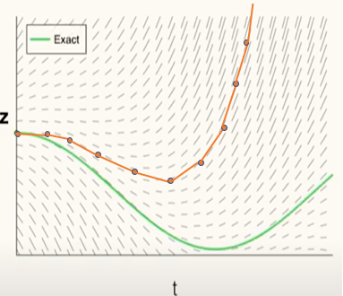
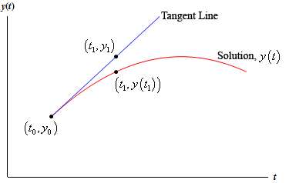
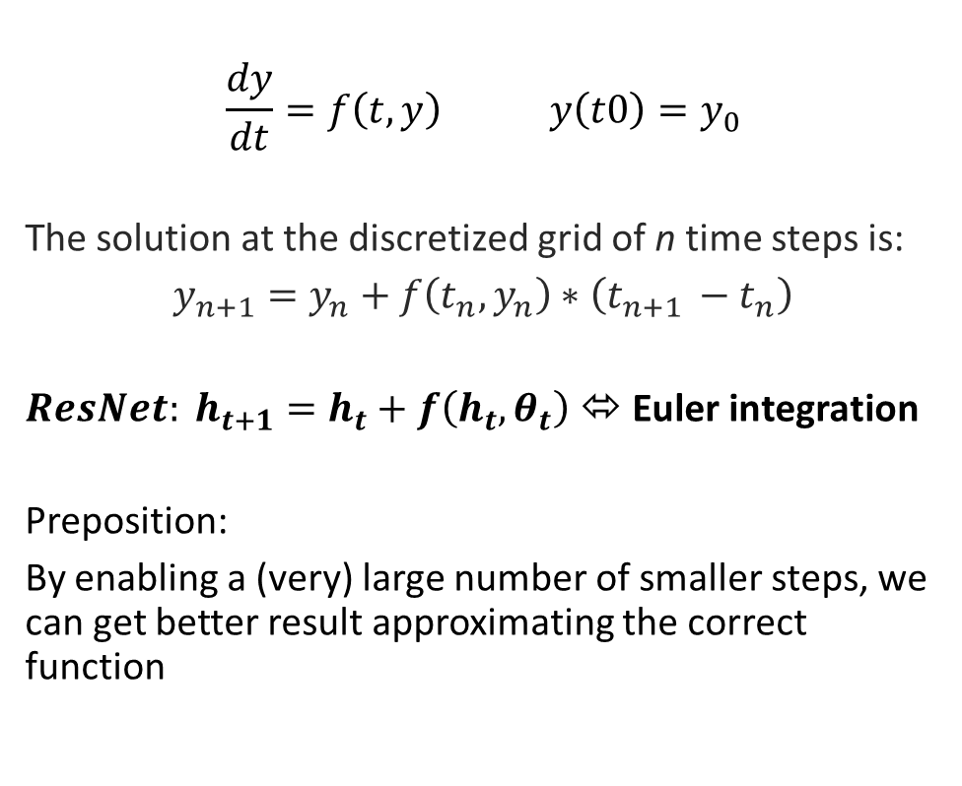
ResNet and Euler method
$$\frac{dy}{dt}=f\left(t,y\right) y\left(t0\right)=y_{0}$$
The solution at the discretized grid of n time steps is:
$y_{n+1}=y_{n}+f\left(t_{n},y_{n}\right)∗\left(t_{n+1 }−t_{n}\right)$
${ResNet: h}_{t+1}=h_{t}+f\left(h_{t},θ_{t}\right)$ ⬄ Euler integration
Preposition:
By enabling a (very) large number of smaller steps, we can get better result approximating the correct function
Notes:
To further elaborate about the connection of ResNet to ODE solving we present the euler method.
Euler method is the simplest method from a family of methods for solving ODEs numericaly called Runge–Kutta method.
At each step in Euler method you evaluate your function according to a small time step and the value of the gradient in that time step.
a chain of residual blocks in a ResNet is basically a solution of the ODE with the Euler method!
But as we can see in the plot, it sometimes goes wrong, and the approximation doesn’t fit the true function.
As said before, if ResNet indeed solves ODEs in Euler method, if we use a more suffisticated solution to solve the ODE, maybe we can improve the ResNet.
By taking larger amount of very small steps, we will hopefully make the approximation fir the true function.

Slide 8
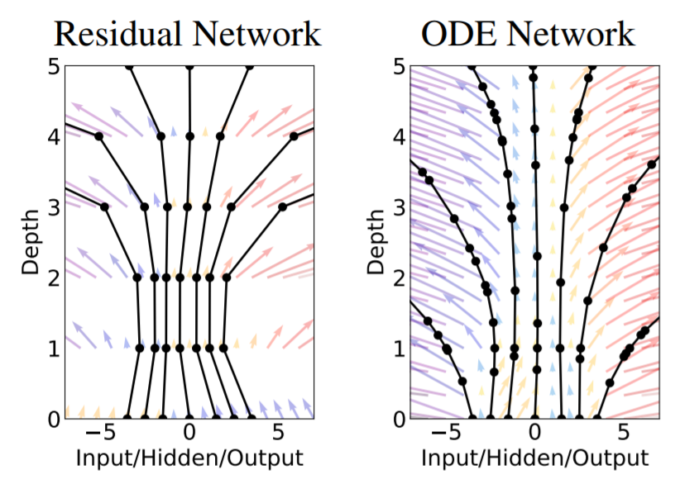
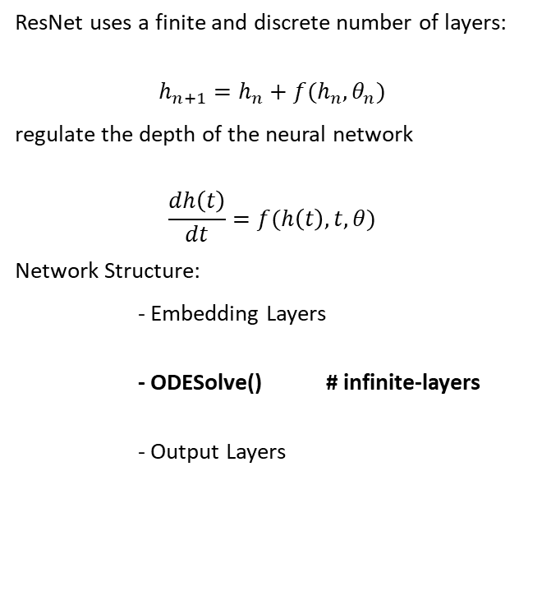
From ResNet to neural ordinary differential equations
ResNet uses a finite and discrete number of layers:
$$h_{n+1}=h_{n}+f(h_{n},θ_{n})$$
regulate the depth of the neural network
$$\frac{dh\left(t\right)}{dt}=f(h\left(t\right),t,θ)$$
Network Structure:
- Embedding Layers
- ODESolve() # infinite-layers
- Output Layers
arXiv:1806.07366 , Chen et al.
Notes:
Here come the Neural ODE to aid.
While a ResNet uses a finite and discrete number of layers, i.e., index ‘t’ goes from 1 up to the number of layers (50, 150 and so on), an ODE net uses a continuous representation of the layers.
By looking deeper into the equation $h_{t+1}=h_{t}+f(h_{t},θ_{t})$, if we take each time a smaller step and add more layers in between, we can parametrize the dynamics of the hidden layers by an ODE: $\frac{dh\left(t\right)}{dt}=f(h\left(t\right),t,θ)$.
And this is exactly how a Neural ODE works.

Slide 9
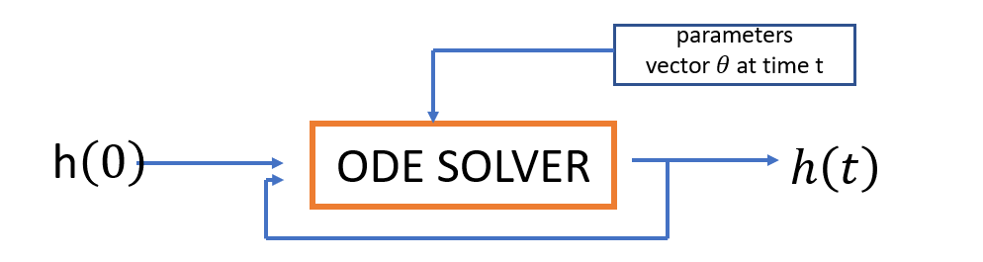
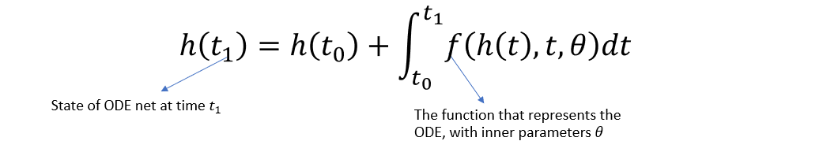
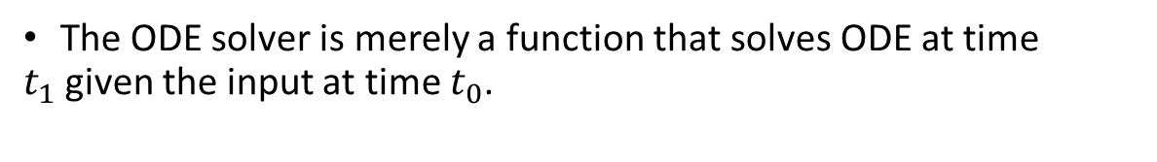
Neural ODE forward pass
The ODE solver is merely a function that solves ODE at time $t_{1}$given the input at time $t_{0}$.
arXiv:1806.07366 , Chen et al.
Notes:
We actually replace all the ResNet’s blocks, which use the skip connection architecture, with one ODE solver.
the ODE solver is a black box function, which solves ODEs.
It encodes the parameters of the network inside of it.
At each time it get the input of the last evaluation (which corresponds to a layer is ResNet) and gives a new output after small time step.
This way we replace entirely the layers with one function.

Slide 10
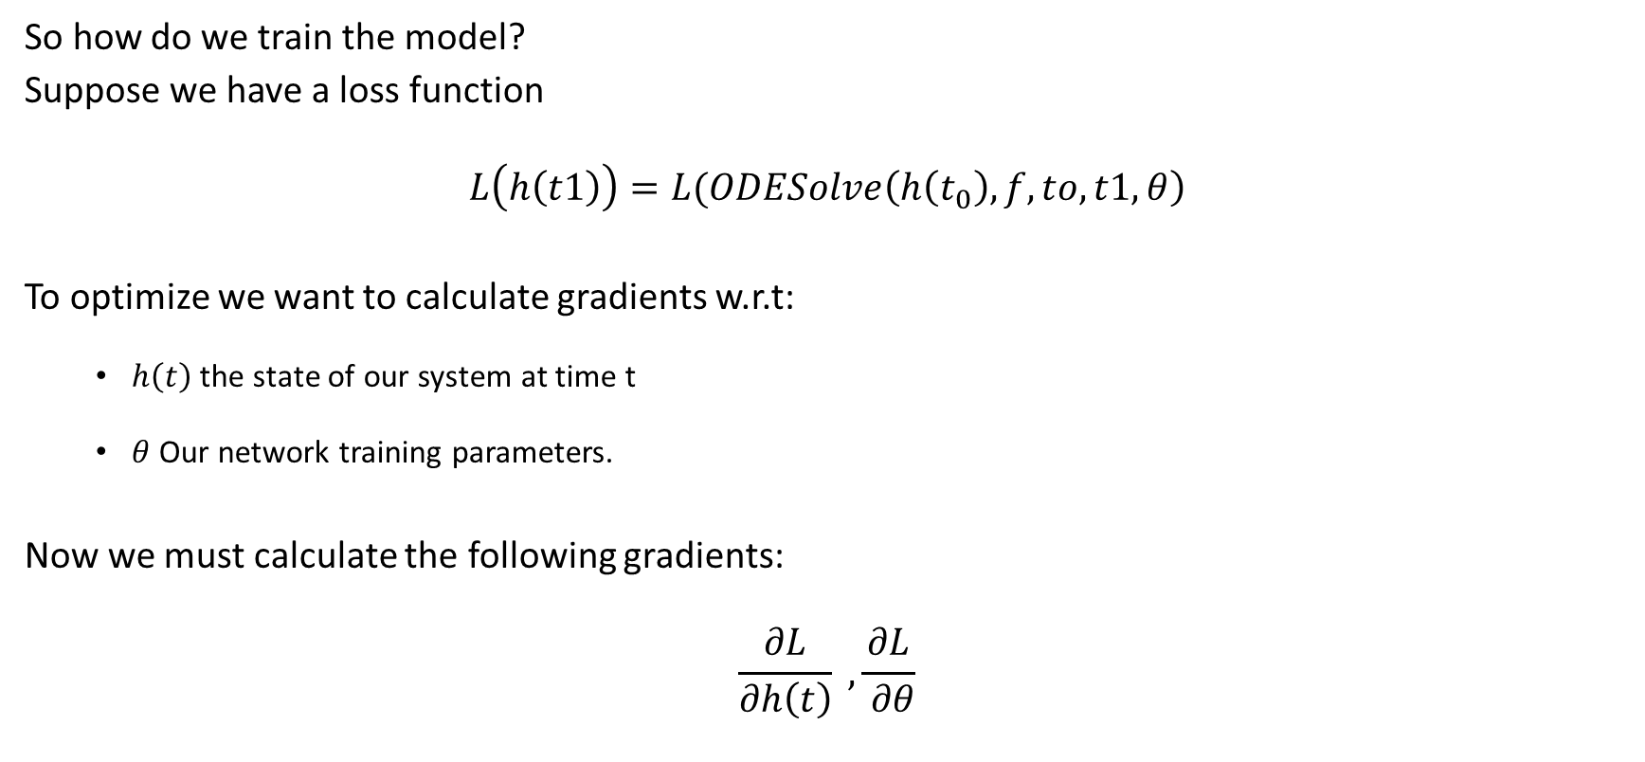
Neural ODE training and backward pass
So how do we train the model?
Suppose we have a loss function
$$L\left(h\left(t1\right)\right)=L(ODESolve\left(h\left(t_{0}\right), f,to,t1,θ\right)$$
To optimize we want to calculate gradients w.r.t:
$h\left(t\right)$the state of our system at time t
$θ$ Our network training parameters.
Now we must calculate the following gradients:
$$\frac{∂L}{∂h\left(t\right)} , \frac{∂L}{ ∂θ}$$
Notes:
we also need to train model.
Our training is based on a gradient descent algorithm, which does the backward pass.
Our model consists of parameters \theta and also states h(t) at any given time step t.
Each state h represents single function evaluation done by the ODE solver, which correspond to a single layer inside a ResNet.
We have to define a loss function L.
and in order to train our model we have to derivate our loss function with respect to the parameters at each time step, and with respect to every system state h.

Slide 11
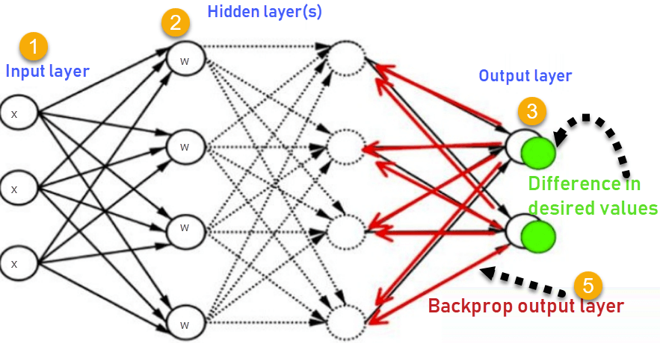
Neural ODE training and backward pass cont.
Backpropagation in DNNs:
How do we apply this to a “black box” ODE solver with so called infinite number of layers?
Notes:
But wait, In the ResNet case, which is also the case for many other NN, we preform backward pass by derivating the loss with respect to the parameters at each layer.
But in our case, Neural ODE model is not built with layers structure. So how can we calculate derivatives backwards if the layers don’t exist ?
We now introduce the adjoint sensitivity method.
Briefly about adjoint sensitivity method:
The adjoint sensitivity method is our way to tell the model’s state h(t) at any given time step.
By knowing the state of the system at time t, we also know the parameters of the system at time t. and thus we can derivate the loss function by them.
since these states are not physical like layers, and are not stored in memory, we have to recreate them, and the adjoint sensitivity does that.

Slide 12
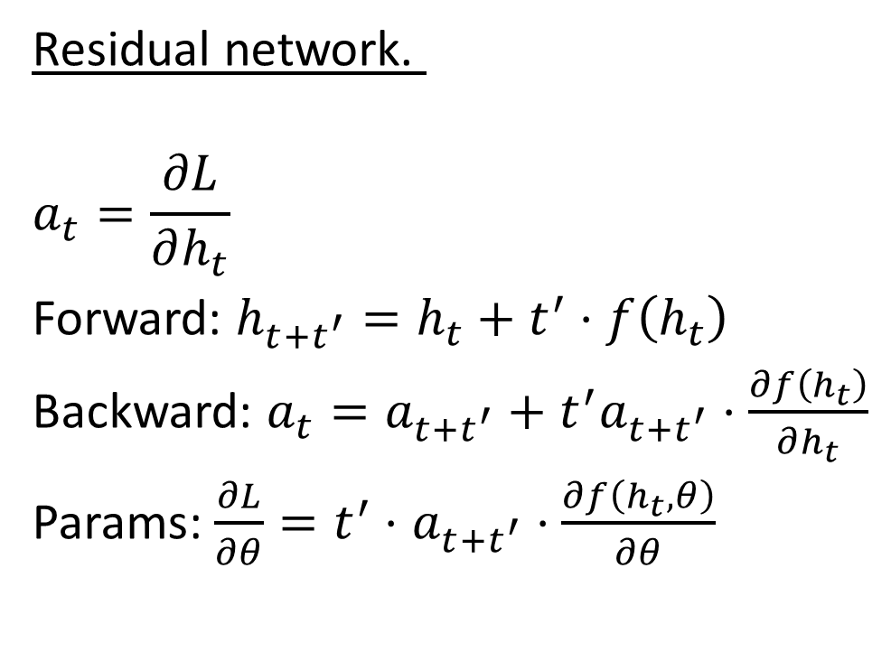
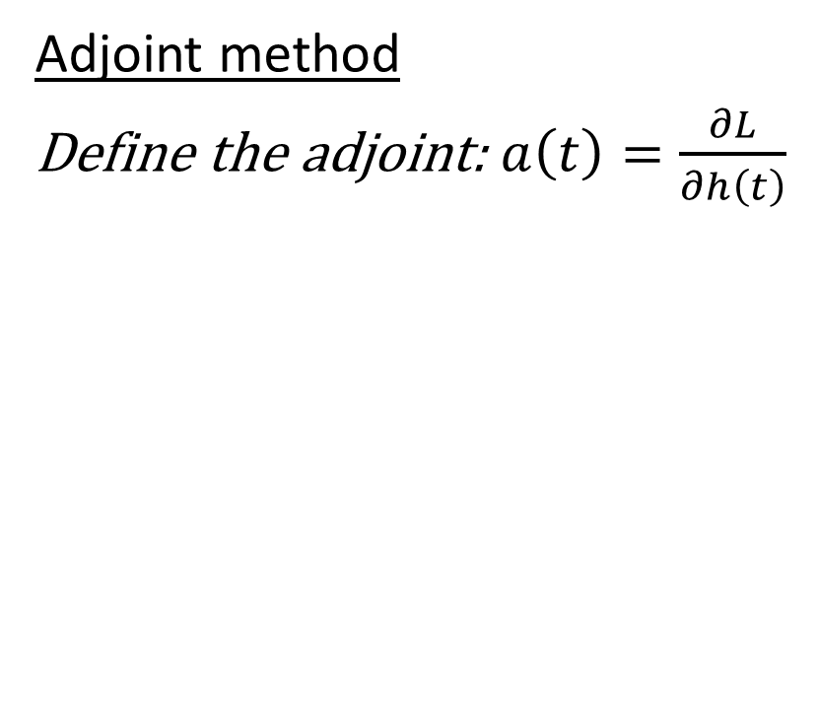
Adjoint sensitivity method continuous-time backpropagation
Residual network.
$$a_{t}=\frac{∂L}{∂h_{t}}$$
Forward: $h_{t+t^{′}}=h_{t}+t^{′}⋅f\left(h_{t}\right)$
Backward: $a_{t}=a_{t+t^{′}}+t^{′}a_{t+t^{′}}⋅\frac{∂f\left(h_{t}\right)}{∂h_{t}}$
Params: $\frac{∂L}{∂θ}=t^{′}⋅$ $a_{t+t^{′}}$ $⋅\frac{∂f\left(h_{t}, θ\right)}{∂θ}$
Adjoint method
Define the adjoint: $a\left(t\right)=\frac{∂L}{∂h\left(t\right)}$
arXiv:1806.07366 , Chen et al.
Notes:
On the left we can see a forward and backward passes in a ResNet for comparison.
The backward pass is built on the chain rule, and the parameters of the ResNet are updated by derivating the loss with respect to the parameters in each layer.
On the right we can see the adjoint method for the Neural ODE.
First we define the adjoint. It is the derivative of the loss with respect to the state of the system.

Slide 13
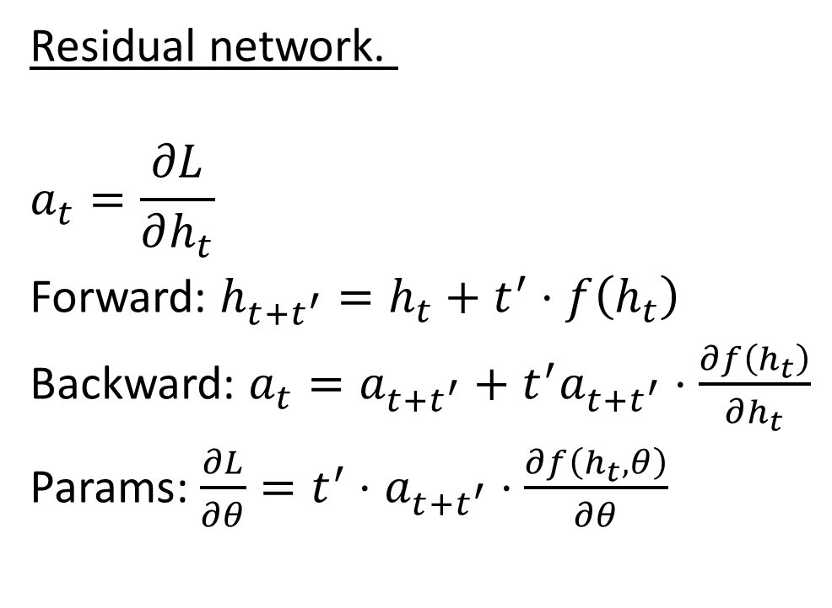
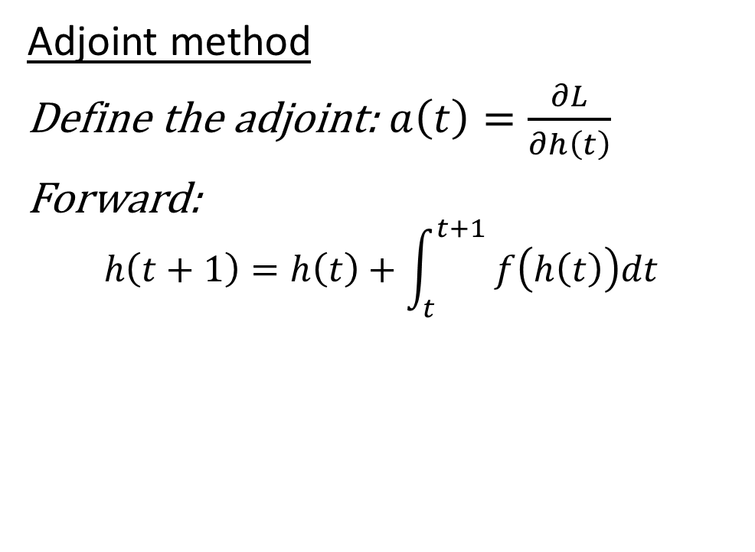
Adjoint sensitivity method Continuous-time Backpropagation
Residual network.
$$a_{t}=\frac{∂L}{∂h_{t}}$$
Forward: $h_{t+t^{′}}=h_{t}+t^{′}⋅f\left(h_{t}\right)$
Backward: $a_{t}=a_{t+t^{′}}+t^{′}a_{t+t^{′}}⋅\frac{∂f\left(h_{t}\right)}{∂h_{t}}$
Params: $\frac{∂L}{∂θ}=t^{′}⋅$ $a_{t+t^{′}}$ $⋅\frac{∂f\left(h_{t}, θ\right)}{∂θ}$
Adjoint method
Define the adjoint: $a\left(t\right)=\frac{∂L}{∂h\left(t\right)}$
Forward:
$$h\left(t+1\right)=h\left(t\right)+\int_{t}^{t+1}{ f\left(h\left(t\right)\right)dt }$$
arXiv:1806.07366 , Chen et al.
Notes:
Next is the forward pass, which is calculated by integrating and solving the ODE.
We can use any ODE solver for this, which means that the ODE solver is indeed a black box.

Slide 14
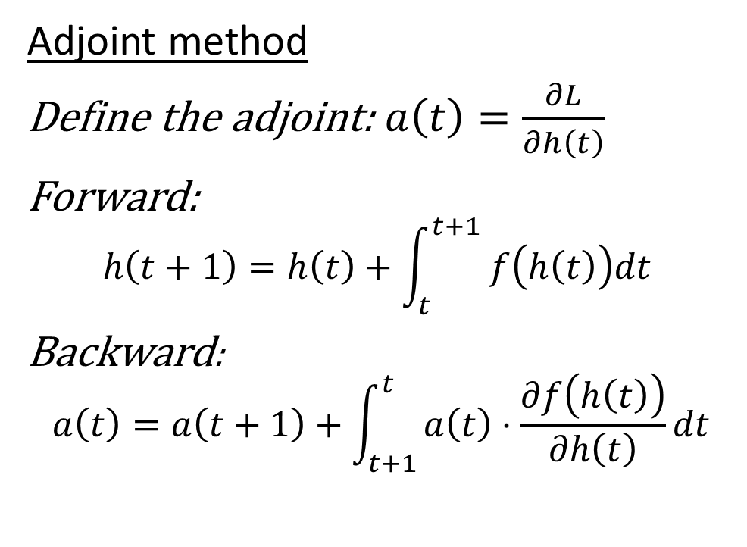
Adjoint sensitivity method Continuous-time Backpropagation
Residual network.
$$a_{t}=\frac{∂L}{∂h_{t}}$$
Forward: $h_{t+t^{′}}=h_{t}+t^{′}⋅f\left(h_{t}\right)$
Backward: $a_{t}=a_{t+t^{′}}+t^{′}a_{t+t^{′}}⋅\frac{∂f\left(h_{t}\right)}{∂h_{t}}$
Params: $\frac{∂L}{∂θ}=t^{′}⋅$ $a_{t+t^{′}}$ $⋅\frac{∂f\left(h_{t}, θ\right)}{∂θ}$
Adjoint method
Define the adjoint: $a\left(t\right)=\frac{∂L}{∂h\left(t\right)}$
Forward:
$$h\left(t+1\right)=h\left(t\right)+\int_{t}^{t+1}{ f\left(h\left(t\right)\right)dt }$$
Backward:
$$a\left(t\right)=a\left(t+1\right)+\int_{t+1}^{t}{a\left(t\right)⋅\frac{∂f\left(h\left(t\right)\right)}{∂h\left(t\right)}dt}$$
Adjoint state
Adjoint Differential Equation
arXiv:1806.07366 , Chen et al.
Notes:
The next step is to do the backward pass.
Since we know the parameters at the end of the forward pass, we know the system state at the final time, which means we know the adjoint at the final time.
We can calculate the previous adjoint by the formula which is seen here.
This formula stems from the definition of the adjoint.
We can solve this equation also by using another ODE solver, only this time it solves backwards in time, because we want to know the previous adjoint.

Slide 15
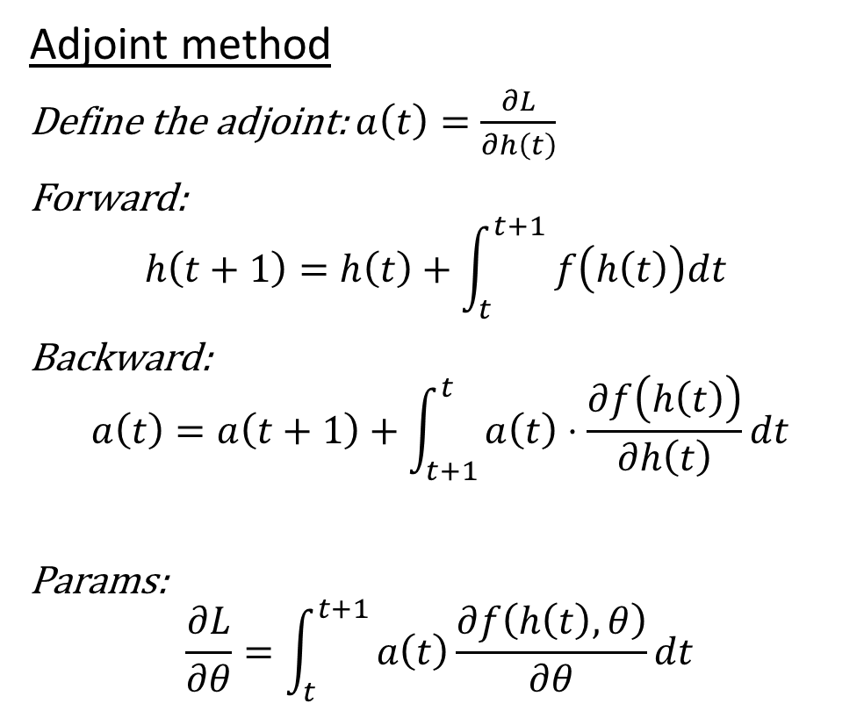
Adjoint sensitivity method Continuous-time Backpropagation
Adjoint method
Define the adjoint: $a\left(t\right)=\frac{∂L}{∂h\left(t\right)}$
Forward:
$$h\left(t+1\right)=h\left(t\right)+\int_{t}^{t+1}{ f\left(h\left(t\right)\right)dt }$$
Backward:
$$a\left(t\right)=a\left(t+1\right)+\int_{t+1}^{t}{a\left(t\right)⋅\frac{∂f\left(h\left(t\right)\right)}{∂h\left(t\right)}dt}$$
Params:
$$\frac{∂L}{∂θ}=\int_{t}^{t+1}{a\left(t\right)\frac{∂f\left(h\left(t\right),θ\right)}{∂θ}dt}$$
Residual network.
$$a_{t}=\frac{∂L}{∂h_{t}}$$
Forward: $h_{t+t^{′}}=h_{t}+t^{′}⋅f\left(h_{t}\right)$
Backward: $a_{t}=a_{t+t^{′}}+t^{′}a_{t+t^{′}}⋅\frac{∂f\left(h_{t}\right)}{∂h_{t}}$
Params: $\frac{∂L}{∂θ}=t^{′}⋅$ $a_{t+t^{′}}$ $⋅\frac{∂f\left(h_{t}, θ\right)}{∂θ}$
Adjoint state
Adjoint Differential Equation
arXiv:1806.07366 , Chen et al.
Notes:
The final step is to calculate the derivative of the loss with respect to the parameters at the wanted system state.
Computing the gradients with respect to the parameters requires evaluating a third integral, which depends on both h(t) and the adjoint a(t).
Solving this equation is possible through automatic differentiation.
Automatic differentiation is also called algorithmic differentiation or in short AutoDiff is a set of techniques to evaluate the derivative of a function specified by a computer program.

Slide 16
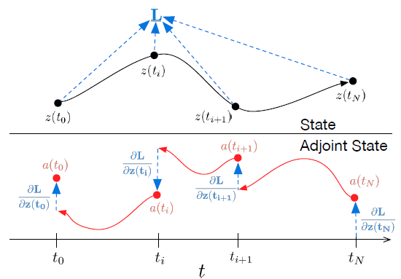
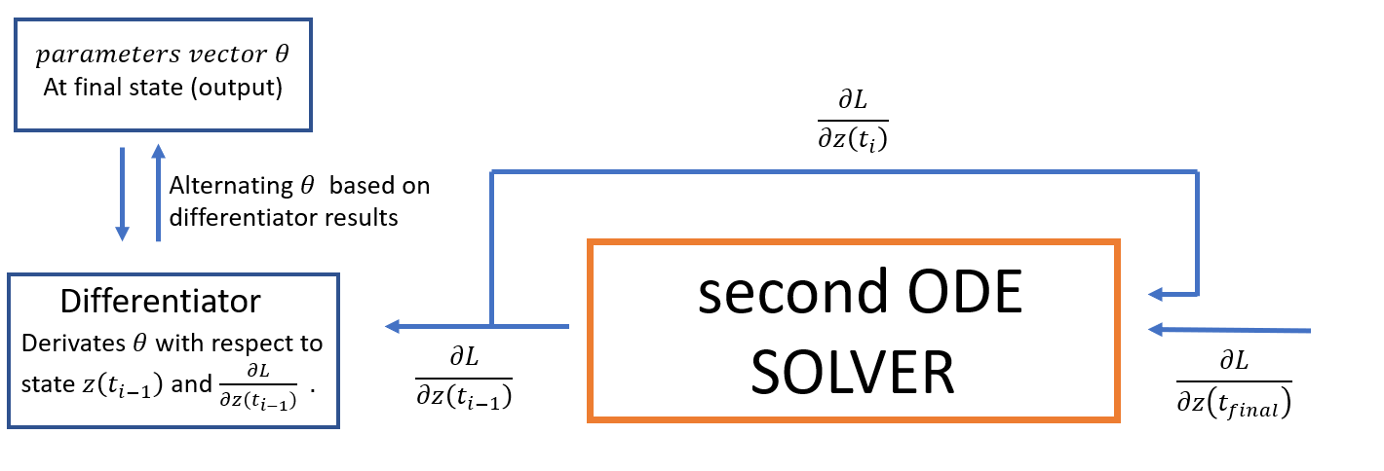
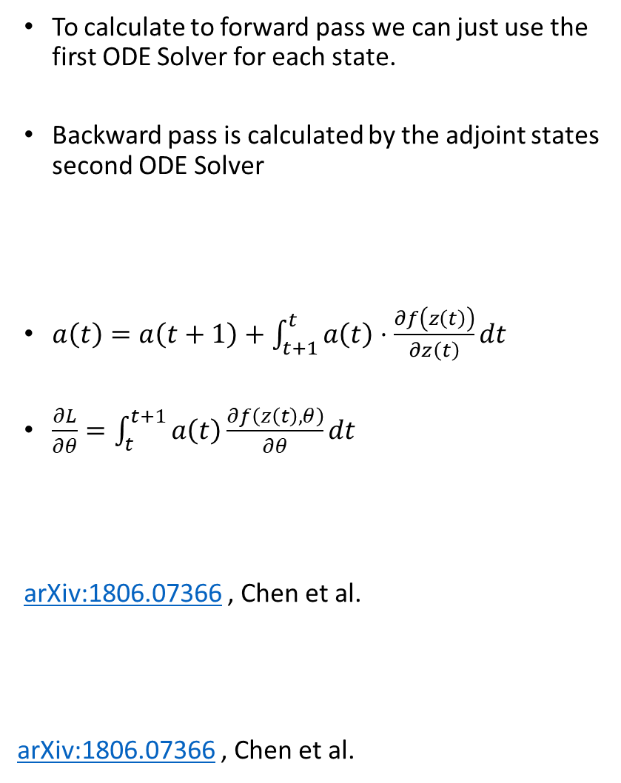
Adjoint sensitivity method continuous-time backpropagation
To calculate to forward pass we can just use the first ODE Solver for each state.
Backward pass is calculated by the adjoint states second ODE Solver
$a\left(t\right)=a\left(t+1\right)+\int_{t+1}^{t}{a\left(t\right)⋅\frac{∂f\left(z\left(t\right)\right)}{∂z\left(t\right)}dt}$
$\frac{∂L}{∂θ}=\int_{t}^{t+1}{a\left(t\right)\frac{∂f\left(z\left(t\right),θ\right)}{∂θ}dt}$
arXiv:1806.07366 , Chen et al.
arXiv:1806.07366 , Chen et al.
Notes:
Here is a visualization of how the forward and backward pass of the model work:
- the upper curve is the forward pass which is calculated using the ODE solver.
- the Lower curve is the backward pass, which is calculated using a second ODE Solver.
Below, there is a visualization of the adjoint calculation.
By using the second ODE solver, and feeding it with the adjoint at a certain time, we can get the adjoint at the previous time step.
From there, as we said, we can calculate the parameters derivatives with an automatic differentiator.
From there, we are updating the parameters.

Slide 17
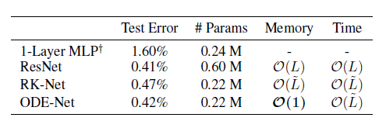
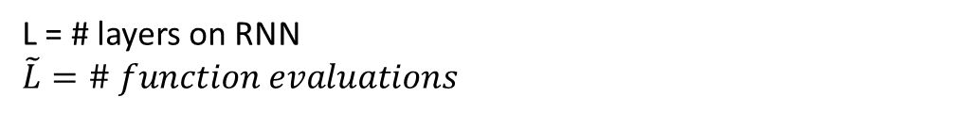
Results and Benefits of ODE-nets
ODE networks have some useful properties:
Memory efficiency – Similar results on MNIST compared to ResNet with 1/3 the parameters
ODE solvers take a tolerance level as an argument- This controls how accurate the solution is at the cost of more function evaluations.
The variable time step aspect can be used for continuous time-series models, unlike RNNs which have inputs at fixed intervals of time.
L = # layers on RNN
$$\tilde{L}=\# function evaluations$$
arXiv:1806.07366 , Chen et al.
Notes:
Now, discussing the model’s advantages.
ODE networks have some really useful properties, we will list only 2 for now:
They are much more memory efficient compared to a ResNets. An ODE-net achieves almost the same performance as a ResNet on MNIST classification with roughly 3 times fewer parameters.
Another advantages is that ODE solvers takes a tolerance level as an argument while solving. This means we can control the accuracy of the solution at the cost of more function evaluations. This can be used as a tradeoff between performance and speed. For example, ODE-nets can be trained with very low tolerance values which can be later relaxed at test time for faster inference.

Slide 18
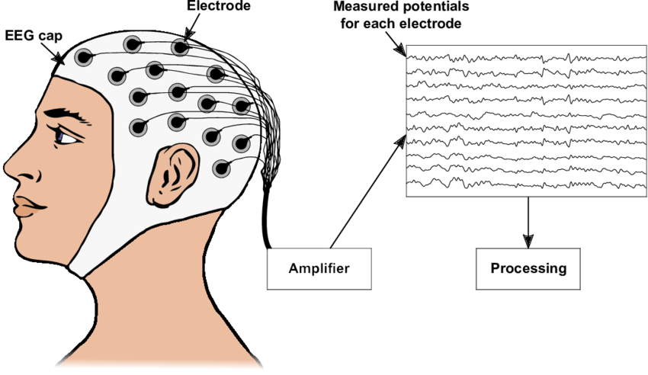
The Data

Slide 19
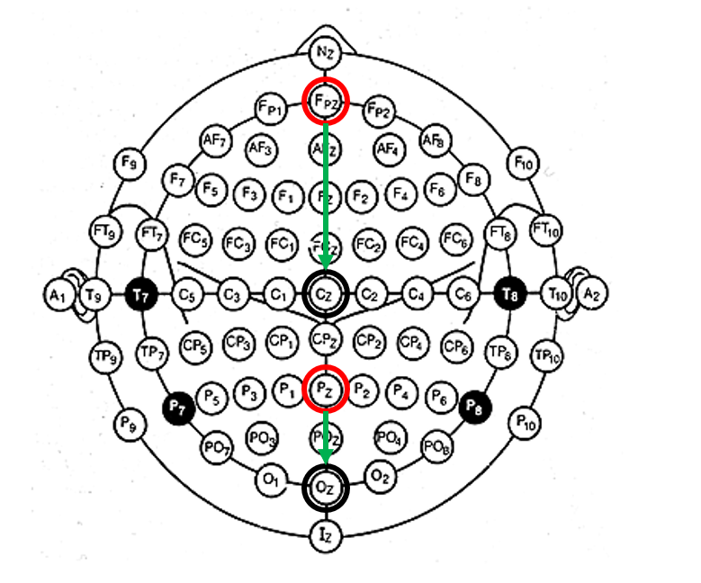
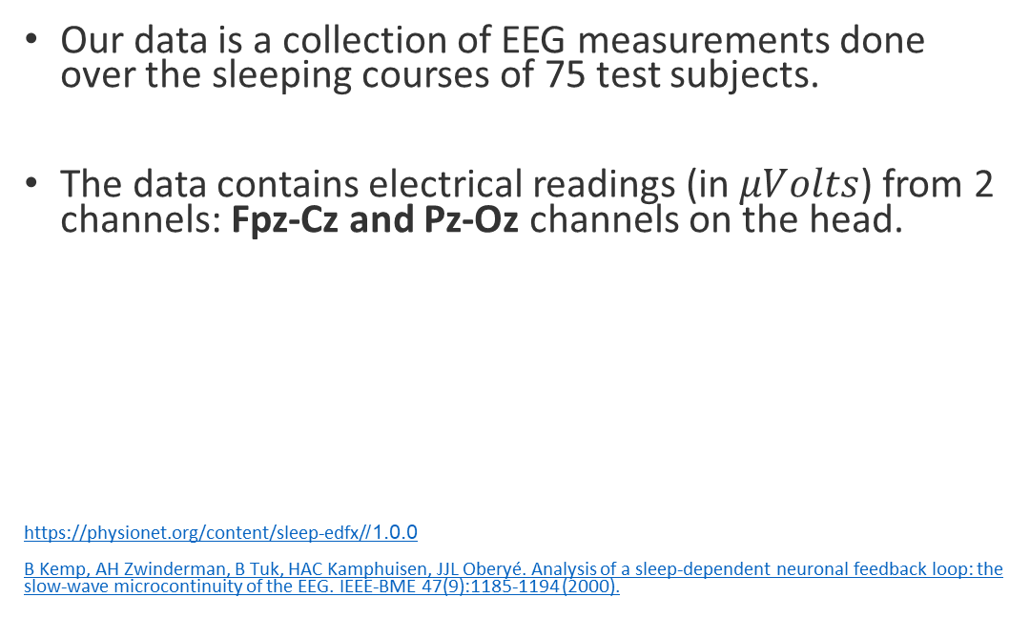
The data
Our data is a collection of EEG measurements done over the sleeping courses of 75 test subjects.
The data contains electrical readings (in $μVolts$) from 2 channels: Fpz-Cz and Pz-Oz channels on the head.
https://physionet.org/content/sleep-edfx/1.0.0/
B Kemp, AH Zwinderman, B Tuk, HAC Kamphuisen, JJL Oberyé. Analysis of a sleep-dependent neuronal feedback loop: the slow-wave microcontinuity of the EEG. IEEE-BME 47(9):1185-1194 (2000).
Notes:
The data is a collection of EED measurements done over sleeping courses of 75 test subjects.
The data contains electrical readings (in $μVolts$) from 2 channels: Fpz-Cz and Pz-Oz which are located on the head.

Slide 20
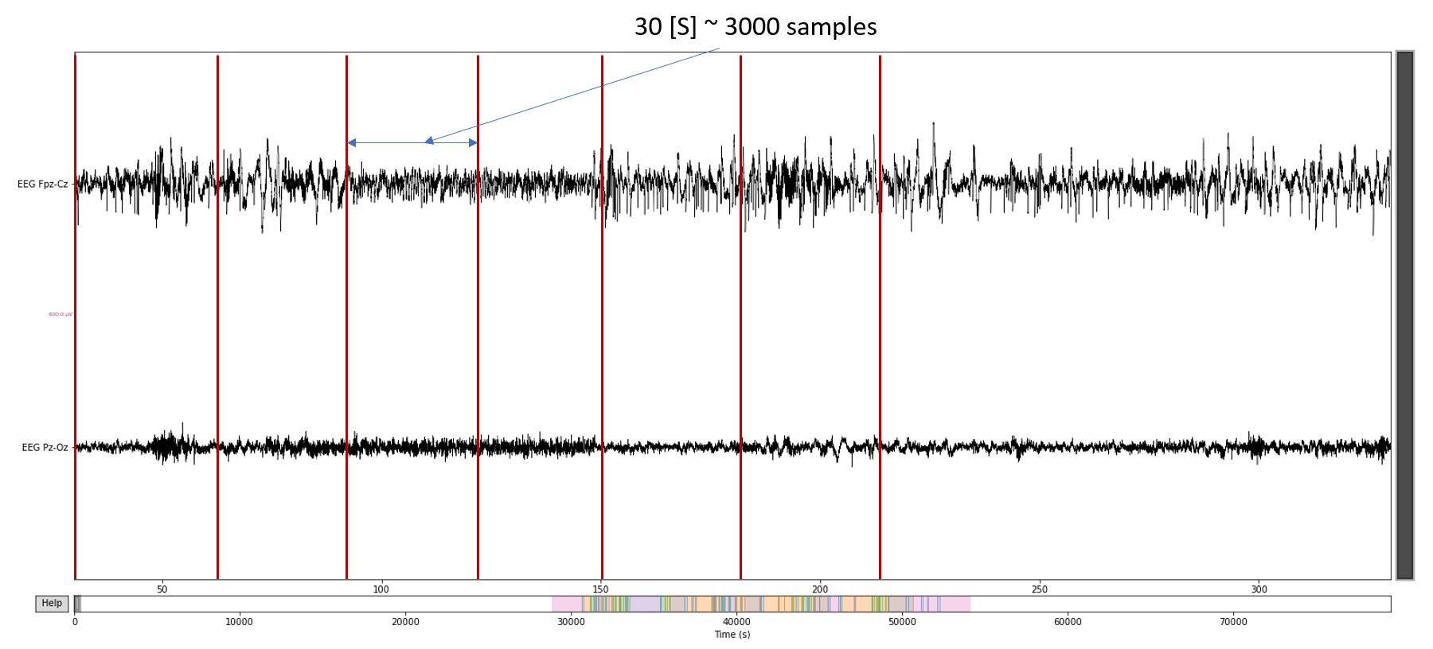
The data
Fs = 100 Hz
The data is divided to 30 seconds of sleeping epochs.
Each epoch is labeled in one out of 5 sleeping stages
(W, S1, S2, S3&4, REM)
Notes:
The electrical signals are read at a frequency of 100Hz.
Every 30 seconds of measurement is called an epoch.

Slide 21
The data
Fs = 100 Hz
The data is divided to 30 seconds of sleeping epochs.
Each epoch is labeled in one out of 5 sleeping stages
(W, S1, S2, S3&4, REM)
Single sleeping epoch:
2 channels x 3000 samples | Label
Notes:
At 100Hz, a 30 second interval corresponds to 3000 samples.
Each epoch is labeled with one of the following sleeping stages, W,S1,S2,S3&4, and REM.
REM stands for rapid eye movements, which is considered to be the stage at which a person is dreaming.

Slide 22
The data
Fs = 100 Hz
The data is divided to 30 seconds of sleeping epochs.
Each epoch is labeled in one out of 5 sleeping stages
(W, S1, S2, S3&4, REM)
Single sleeping epoch:
Test – Train split:
2 channels x 3000 samples | Label
80%
20%
Epoch 1 | Epoch 2 | …
Notes:
A subject’s night sleep consists of around 800 epochs.
In some of the experiments we present further ahead, a single subject is divided to 80% training epochs and 20% test epochs.

Slide 23
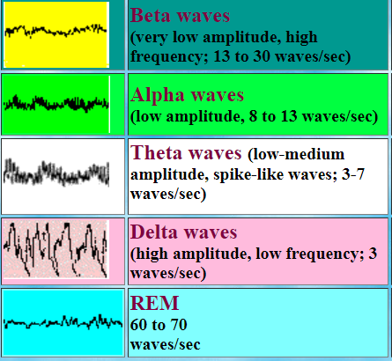
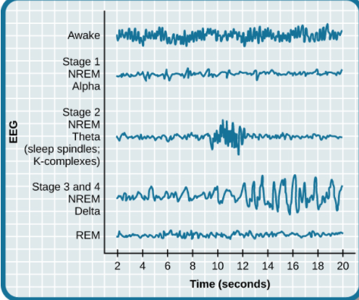
The data Sleeping stages
Beta waves – the person is awake
Alpha waves – The person is awake and relaxed with closed eyes
Theta waves – The person is sleepy/ already sleeping.
Delta waves – The person is in deep sleep state.
REM (Rapid eye movement) – Paradoxal, deep sleep but similar to wake patterns, the person is probably dreaming.
Notes:
The brain activity of a person can be divided to several wave patterns which occurs in the sleeping stages described before.
These wave patterns differ in amplitude and frequency.
Some of the sleeping stages are known to contain only specific wave patterns.
For example:
Beta waves often indicate that a person is awake.
Delta wave indicate the person is in deep sleep state.
In the lower graph you can see the sleeping stages and their corresponding brain waves.
It is some times hard to associate a single sleeping stage with a certain wave pattern because sometimes 2 wave patterns occur together.

Slide 24
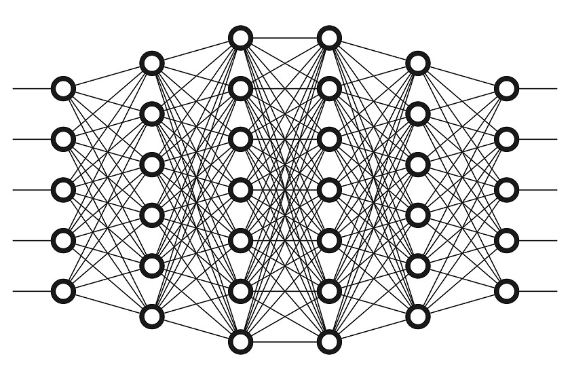
The Model

Slide 25
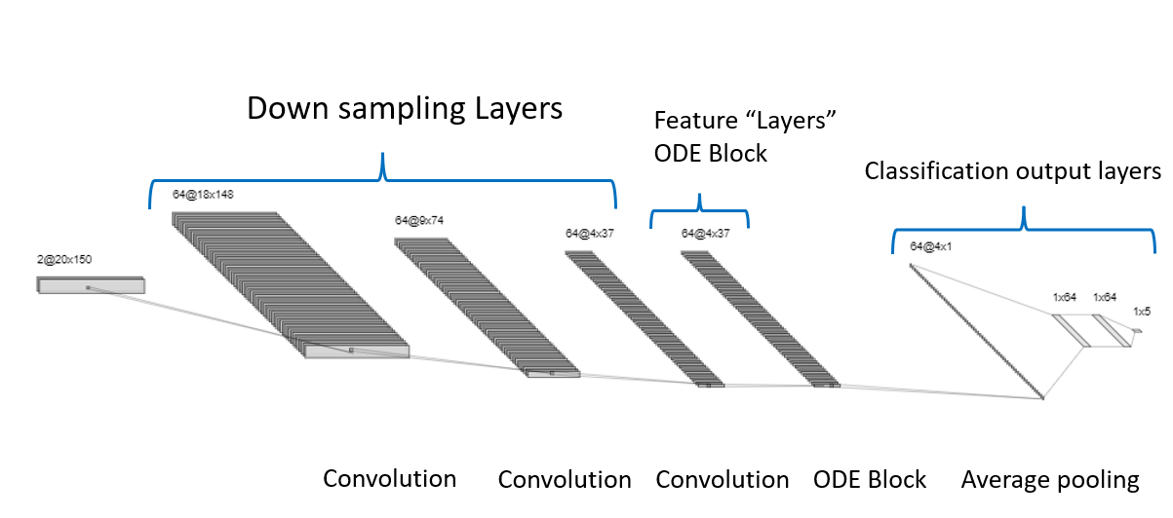
Basic model The architecture
ODE block consists of:
ODE function:
Norm layer
ReLU
Convolutional layer
Norm layer
ReLU
Convolutional layer
Norm layer
Tolerance parameters and ODE
solver:
Tol = 1e-3
ODE solver – “dopri”, Dormand Prince (ODE45 in matlab)

Slide 26
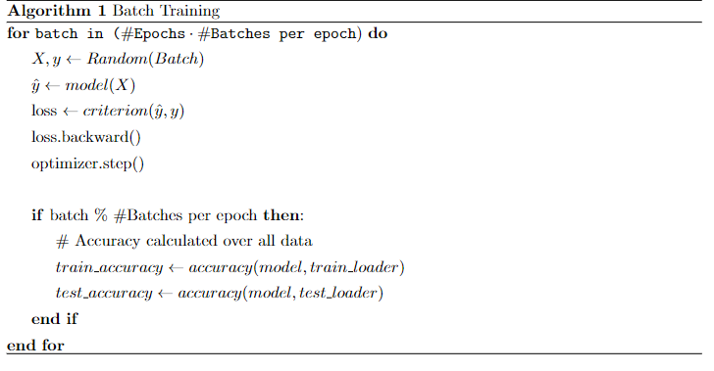
Training
Training configurations that need to be set are:
• Optimizer.
• Loss function.
• Learning rate
• Batch size.
Notes:
1. the training algorithm is a basic learning algorithm in deep learning. The framework is PyTorch and the algorithm is as follows:
In the loss.backward() we calculate the gradients and use it in optimizer.step() with the specific optimizer.
2. To train the network we need to choose the optimizer which will best fit to the model. The optimizer has a set of hyper parameters that need to be selected such as learning rate. Also, we use stochastic gradient descent family of algorithms where we choose a random batch to calculate the gradients

Slide 27
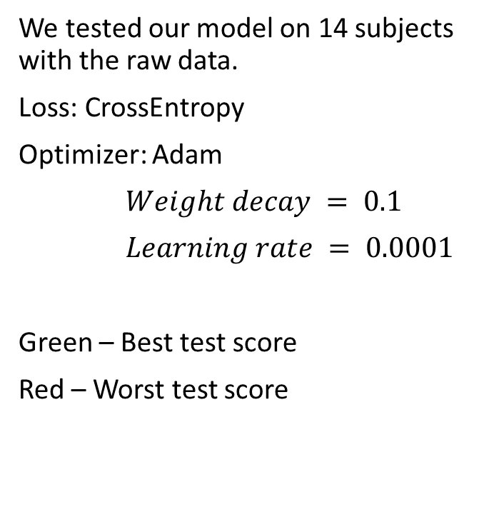
Results: raw data
ID | subject | train accuracy | test accuracy
1 | SC4001E0 | 0.4829 | 0.4702
2 | SC4011E0 | 0.6251 | 0.6091
3 | SC4021E0 | 0.6748 | 0.6029
4 | SC4031E0 | 0.6601 | 0.6526
5 | SC4041E0 | 0.5703 | 0.5325
6 | SC4051E0 | 0.619 | 0.5149
7 | SC4071E0 | 0.7478 | 0.6103
8 | SC4081E0 | 0.3073 | 0.3142
9 | SC4091E0 | 0.596 | 0.5708
10 | SC4101E0 | 0.6165 | 0.5727
11 | SC4111E0 | 0.6137 | 0.5838
12 | SC4121E0 | 0.6366 | 0.519
13 | SC4131E0 | 0.6501 | 0.5854
14 | SC4141E0 | 0.6119 | 0.62
We tested our model on 14 subjects with the raw data.
Loss: CrossEntropy
Optimizer: Adam
$Weight decay = 0.1$
$Learning rate = 0.0001$
Green – Best test score
Red – Worst test score
max | 65.3%
min | 31.4%
avg | 55.4%
med | 57.8
Notes:
These results are the preliminary results which we have shown in the midterm presentation.
We chose manually the hyper parameters which are the optimizer, wight decay and learning rate.
We tested the model on 14 subjects with the raw data. No transformation whatsoever was done on the data.
The best result is shown in green, and the worst in red. 65% best case and 31% for the worst case in terms of test accuracy.
This experiment with raw data was done for 2 reasons:
1. as reference to the upcoming improved results
2. evaluate the quality of the data and how close the distribution between test subjects

Slide 28
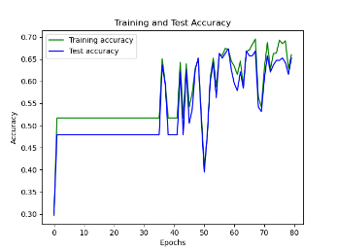
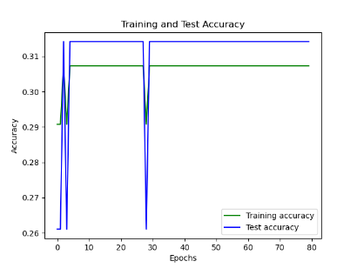
Preliminary results over 14 test subjects Cont.
ID | subject | train accuracy | test accuracy
ID | subject | train accuracy | test accuracy
4 | SC4031E0 | 0.6601 | 0.6526
8 | SC4081E0 | 0.3073 | 0.3142
Notes:
Eventually we can see the learning curves. The hyper parameters weren’t fine tuned and the learning curvature seems pretty noisy also because it’s a small data set( training and testing on the same test subject)

Slide 29
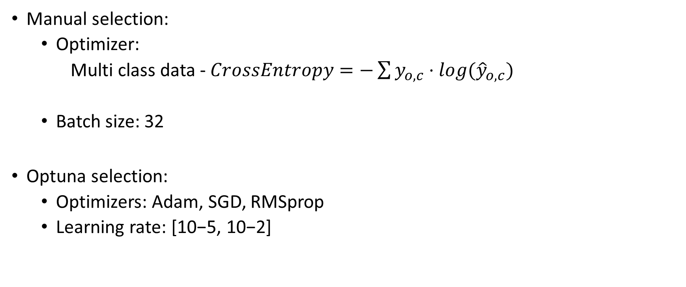
Choosing the hyper parameters
Manual selection:
Optimizer:
Multi class data - $CrossEntropy=−\sum{y_{o,c}⋅log{(\hat{y}}_{o,c}})$
Batch size: 32
Optuna selection:
Optimizers: Adam, SGD, RMSprop
Learning rate: [10−5, 10−2]
Notes:
After acquiring the preliminary results, we sought a way to improve our model and also refine the data.
We chose some of the hyper parameters manually and some Optuna.
The data is a multi-class data, namely we have 5 different sleeping stages. Each sleeping epoch (3000 samples) need to be classified to one of them. A good choice for multi-class data as a loss function is the Cross-Entropy. We chose this manually.
The batch size was also selected to be 32.
2. For the optimizer and optimizer parameters such as learning rate, we had to methodically find the best parameters. For this task we chose a python library called Optuna which is a hyper parameter optimization framework
We gave it a range of learning rates, and 3 optimizers to choose from Adam, SGD, RMSprop.
Shortly on optuna: Optuna is a software framework for automating the optimization process of these hyperparameters. It automatically searches for and finds optimal hyperparameter values by trial and error for excellent performance. Specifically, it employs a Bayesian optimization algorithm called Tree-structured Parzen Estimator.

Slide 30
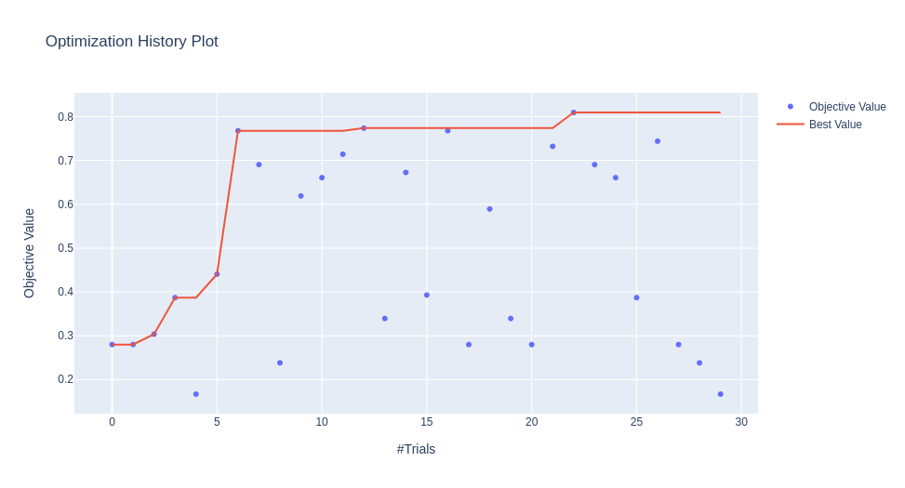
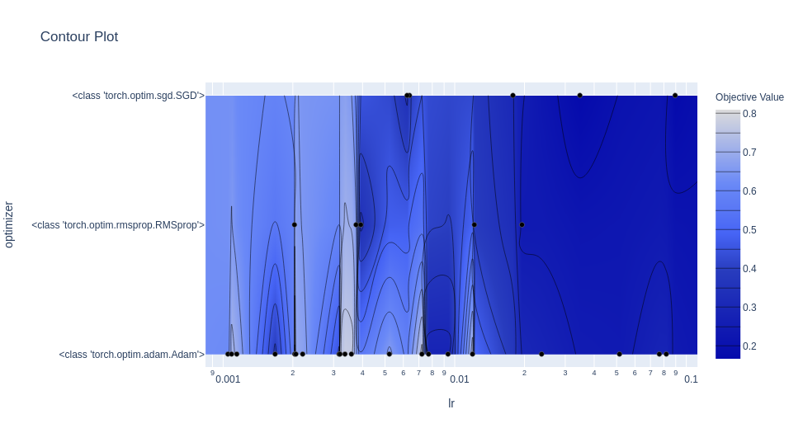
Optuna’s history record of trials
Learning rate: 0.002037
Optimizer: Adam
Notes:
This way we could let optuna run a number of trials in a long time and finding the best hyper parameters. We let it run 30 trials.
Eventually the best learning rate found is 0.002 and the best optimizer is Adam.
The value at which optuna does the optimization is the test accuracy of the model which here is named the objective value.
On the right we can see the contour plot which shows the relation between the different hyper parameters.

Slide 31

Feature Engineering

Slide 32
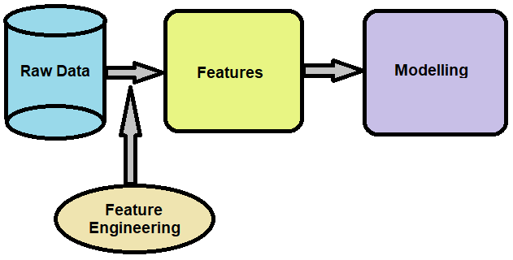
Feature engineering
Feature Creation: Creating features involves identifying the variables that will be most useful
Transformations: Transformation involves manipulating the predictor variables to improve model performance
Feature Extraction: Feature extraction is the automatic creation of new variables by extracting them from raw data.
Feature Selection: Determine which features are irrelevant and should be removed, which features are redundant and should be removed, and which features are most useful for the model and should be prioritized.
Notes:
Feature engineering creates features from the existing raw data in order to improve the performance of the machine learning algorithms.
Feature engineering consists of creation, transformation, extraction, and selection of features, also known as variables, that are most conducive to creating an accurate ML algorithm
Feature Creation: Creating features involves identifying the variables that will be most useful in the predictive model. This is a subjective process that requires human intervention and creativity. Existing features are mixed via addition, subtraction, multiplication, and ratio to create new derived features that have greater predictive power.
Transformations: Transformation involves manipulating the predictor variables to improve model performance; e.g. ensuring the model is flexible in the variety of data it can ingest; ensuring variables are on the same scale, making the model easier to understand; improving accuracy; and avoiding computational errors by ensuring all features are within an acceptable range for the model.
Feature Extraction: Feature extraction is the automatic creation of new variables by extracting them from raw data. The purpose of this step is to automatically reduce the volume of data into a more manageable set for modeling. Some feature extraction methods include cluster analysis, text analytics, edge detection algorithms, and principal components analysis.
Feature Selection: Feature selection algorithms essentially analyze, judge, and rank various features to determine which features are irrelevant and should be removed, which features are redundant and should be removed, and which features are most useful for the model and should be prioritized.

Slide 33
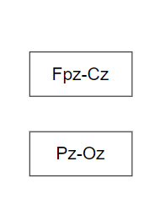
Band pass over 75 test subjects
The annotations which were given by the analysts stemmed from 2 main properties:
Signal amplitude
Signal frequency
Input channels:
Notes:
The original input channels (Fpz-Cz, Pz-Oz) are EEG signals that have this information inside, and we would like to exploit our prior knowledge of the labeling procedure.

Slide 34
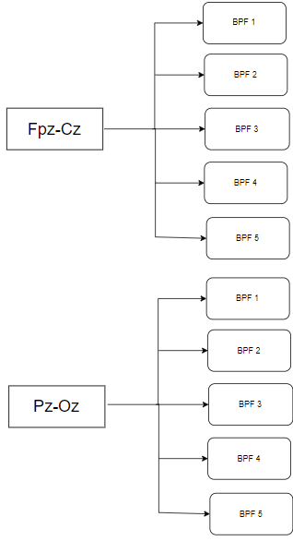
Band pass over 75 test subjects
Input channels:
Notes:
The plan is then to create extra features and channels by passing the original channels through 5 different band pass filters.
The frequency bands of the filters are covering up the sleeping stages frequencies.
The idea is if some sleeping stage is characterized by slow waves for example, the most significant channel for that specific labeled epoch would be the channel with the respective band. This hopefully would simplify the data representation and improve the system performance.

Slide 35
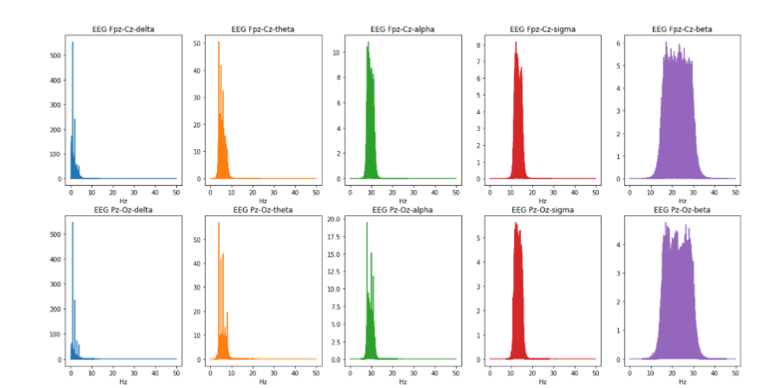
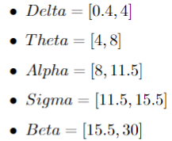
Band pass over 75 test subjects
Frequency domain view on the band passed channels
Notes:
So that’s what we did, choosing five different bands. The values on the left are of 5 different frequencies bands in Hz.
They were chosen empirically, and to fit the most to the values discussed in the literature about sleeping stages.
On the right are the actual signals after passing through the chosen filters. They are here viewed on the frequency domain just for visualization. Eventually the data inserted to the model is time series data.

Slide 36
Band pass over 75 test subjects
Frequency domain view on the band passed channels
Input dimensions:
10 channels x 3000 samples | Label
Notes:
So that’s what we did, choosing five different bands. The values on the left are of 5 different frequencies bands in Hz.
They were chosen empirically, and to fit the most to the values discussed in the literature about sleeping stages.
On the right are the actual signals after passing through the chosen filters. They are here viewed on the frequency domain just for visualization. Eventually the data inserted to the model is time series data.

Slide 37
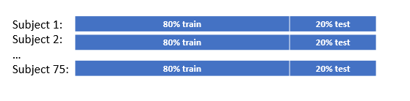
Results - Band pass over 75 test subjects
The feature engineering was done on all 75 test subjects, and then data split to 80% for training and 20% for testing.

Slide 38

Results - Band pass over 75 test subjects
The feature engineering was done on all 75 test subjects, and then data split to 80% for training and 20% for testing.
For each subject the model score was evaluated.

Slide 39
Results - Band pass over 75 test subjects
Test accuracy statistics for the 75 different subjects:
max | 93.5%
min | 43.8%
avg | 74.5%
med | 77.512%
Notes:
The actual results are as follows. The model best score was 93.5% percent for the test accuracy.
Worst result is 43.8%. 93.5% accuracy for a single subject proves the capability of the model to deal with this EEG biological data.
More importantly the avg score is 74.5 % and the median score is 77.512% which are both above 70%.
Note:
The model hyper-parameters were optimized for a single subject. Optimization of the hyper parameters such as learning rate and optimizer for each of the 75 subjects would certainly achieve a better overall result. But it would take to much time and its not the main purpose of the project which is to evaluate the Neural ODE model capability to handle the sleeping data.

Slide 40

Results - Band pass over 75 test subjects
Test accuracy statistics for the 75 different subjects:
max | 93.5%
min | 43.8%
avg | 74.5%
med | 77.512%
Notes:
As before we can look at the learning curve with the testing and training accuracy alongside each other. The curve is of the best subject which reached 93.5% accuracy. The trend is still noisy and overfit the data which is reasonable given the fact training and testing are done on a single subject. The data size used for training the model is relatively small.

Slide 41
Results - Band pass over 75 test subjects
We want to understand the results and the improvement observed:
Notes:
The black box model improved because of the feature engineering. We still would like to understand and learn from the improvement observed

Slide 42
Results - Band pass over 75 test subjects
We want to understand the results and the improvement observed:
Why breaking the data to different frequency bands improved the model performance?
Notes:
Two required question arising from the experiment.
Why breaking data to bands helped achieving better results? Can we do other feature engineering to achieve an even better results?

Slide 43
Results - Band pass over 75 test subjects
We want to understand the results and the improvement observed:
Why breaking the data to different frequency bands improved the model performance?
Which frequency bands are the most significant to the results.
Notes:
2. If we understand the improvement, which frequency bands are the most important to our model score

Slide 44


Ablation study
An ablation study is the study of removement of a component from an AI system.
In this context, we dropped frequency bands from the input to determine their importance.
2 ablation studies were conducted:
Notes:
In order to do that we did an ablation study. ablation is the removal of a component of an AI system. An ablation study studies the performance of an AI system by removing certain components, to understand the contribution of the component to the overall system.
In our case, we can look at the system as the input channels + model.
The components we chose to remove are the frequency bands or the input channels after the feature engineering procedure.

Slide 45
Ablation study
An ablation study is the study of removement of a component from an AI system.
In this context, we dropped frequency bands from the input to determine their importance.
2 ablation studies were conducted:
Dropping a single frequency band and using remaining 4 bands.
Notes:
In order to do that we did an ablation study. ablation is the removal of a component of an AI system. An ablation study studies the performance of an AI system by removing certain components, to understand the contribution of the component to the overall system.
In our case, we can look at the system as the input channels + model.
The components we chose to remove are the frequency bands or the input channels after the feature engineering procedure.
1 experiment is to drop a single frequency band. For a worth result we can induce that this band is significant to the model performance

Slide 46
Ablation study
An ablation study is the study of removement of a component from an AI system.
In this context, we dropped frequency bands from the input to determine their importance.
2 ablation studies were conducted:
Dropping a single frequency band and using remaining 4 bands.
Dropping 4 frequency bands and using a single band.
Notes:
In order to do that we did an ablation study. ablation is the removal of a component of an AI system. An ablation study studies the performance of an AI system by removing certain components, to understand the contribution of the component to the overall system.
In our case, we can look at the system as the input channels + model.
The components we chose to remove are the frequency bands or the input channels after the feature engineering procedure.
Second experiment is to keep only 1 band and look at how well the model performing with only this frequency band as input.

Slide 47


Ablation study – drop a single frequency band
Study conducted on 15 test subjects.
The model score evaluated using 4/5 of the original channels.
Notes:
Dropping the alpha, theta, sigma and beta bands yielded a similar accuracy results while dropping the delta band affected the accuracy the most.

Slide 48

Ablation study – drop a single frequency band
Removal of the delta wave frequency band yielded the worst results:
Notes:
The table shows three statistics values: standard deviation, median, mean of the accuracy of training and testing over the 15 test subjects, while removing each time different frequency band
The marked rows are of the results with the removed delta band. Removal of the delta wave frequency band yielded the worst results

Slide 49

Ablation study – drop a single frequency band
Removal of the delta wave frequency band yielded the worst results: 27% worse than the second worst result of the removed sigma band.
Notes:
The result in the case of the delta band for the mean test accuracy is 0.554 which is 27% worth than the second worst result of the dropped sigma band. To see how significant it is,

Slide 50

Ablation study – drop 4 frequency bands
The model score evaluated using 1/5 of the original channels.
Notes:
After the results of the previous experiment, the required experiment is training and testing with 1 band only. Namely, keeping single band as input instead of dropping single band.

Slide 51

Ablation study – drop 4 frequency bands
Delta wave frequency band yielded the best results:
Notes:
The marked rows are of the results with the delta band again. The result in the case of the delta band for the mean test accuracy is 0.726

Slide 52

Ablation study – drop 4 frequency bands
Delta wave frequency band yielded the best results: 49% better than the second-best result of the theta band.
Notes:
which is 49% better than the second best result of the theta band.

Slide 53
Inter-subject training and testing
All the experiments up until now had the data divided in this form:
Subject 1:
Subject 2:
…
Subject 75:
80% train | 20% test
80% train | 20% test
80% train | 20% test
Notes:
Up until now we evaluated the model in performance of classification on a single subject

Slide 54
Inter-subject training and testing
All the experiments up until now had the data divided in this form:
Subject 1:
Subject 2:
…
Subject 75:
80% train | 20% test
80% train | 20% test
80% train | 20% test
In the following experiment the test is done inter-subject wise, i.e., train according to 80% of subjects and test according to 20% “never before” seen subjects:
Subject 1:
Subject 2:
…
Subject 60:
Subject 61:
Subject 62:
…
Subject 75:
100% train
100% train
100% train
100% test
100% test
100% test
Notes:
The different test subjects may have a distribution which is not similar thus, we can’t assume good generalization of the model when training on some subjects and testing on an unseen test subjects.
nevertheless, we tried to do the inter subjects training and testing. The split ratio is still 20%-80% and it achieved by taking 60 subjects as train group and 15 subjects as testing group.

Slide 55

Inter-subject K-fold testing
K- fold testing - use a limited sample in order to estimate how the model is expected to perform in general on data not used during the training of the model.
5 experiments
60 subjects selected for training
15 subjects selected for test
Illustration of 5-fold testing in 10 subjects
Notes:
How do we know how well the model is performing on unseen data (or unseen test subject) given we have a limited sample? The answer is k-fold which refer usually to k-fold cross validation.
The procedure has a single parameter called k that refers to the number of groups that a given data sample is to be split into.
Cross-validation is primarily used in applied machine learning to estimate the skill of a machine learning model on unseen data: That is, to use a limited sample in order to estimate how the model is expected to perform in general when used to make predictions on data not used during the training of the model.
What we did is a bit different then the common k-fold cross validation where test subject is trained k-1 times and tested 1 times: Here in each experiment, we choose randomly the groups allowing each subject to be in the test group more then once, like here in the illustration subject 3 is in the test group in both experiment 4 and 5.
In our case of the experiment in compare t the illustration shown in the table, we used 60 subjects for training and 15 for testing that were chosen each of the five times randomly.

Slide 56
Inter-subject K-fold testing
K- fold testing - use a limited sample in order to estimate how the model is expected to perform in general on data not used during the training of the model.
5 experiments
60 subjects selected for training
15 subjects selected for test
Illustration of 5-fold testing in 10 subjects
max | 74%
min | 65.8%
avg | 70%
med | 69.6%
Testing accuracy overall statistics of 5 experiments:
Notes:
1. Maximum score is 74% (similar to the average score of the single subjects experiment)
2. Average score is 70%. This is pretty good and yet again proves the capability of the neural ODE model to handle the data even if its an inter subjects data and achieve a much better result then a normal guessing.
3. The results also show that indeed the model performed not as good as he performed on a single subject overall
We achieved for a single subject (in the best case) a test accuracy of 93.5% and the average score was 74% with a lot of test subjects with score higher then 80%.
For further study on inter-subject classification more procedure may need to be done to bring the different subject's distribution closer before fed to the neural network.

Slide 57
Conclusions
75 subjects with 5 band pass filters
Neural ODE model perform well with time series data in the form of EEG signals.
Applying 5 frequency band filters on the data achieved the best results.
max | 93.5%
min | 43.8%
avg | 74.5%
med | 77.5%
Notes:
Project purpose was to evaluate the capability of the Neural ODE model with handling time series data and more specifically EEG signals during sleep period.
The model was proven to work well and achieved a fairly high result on the single subject experiment.

Slide 58
Conclusions
75 subjects with 5 band pass filters
Neural ODE model perform well with time series data in the form of EEG signals.
Applying 5 frequency band filters on the data achieved the best results.
Delta band affected the most:
max | 93.5%
min | 43.8%
avg | 74.5%
med | 77.5%
Notes:
As we learned from the ablation study delta band was very significant. Why the delta band affected that much?

Slide 59

Conclusions
75 subjects with 5 band pass filters
Neural ODE model perform well with time series data in the form of EEG signals.
Applying 5 frequency band filters on the data achieved the best results.
Delta band affected the most:
most common sleeping stages are 2,3 and 4.
Sleeping stages 3 and 4 are characterized by high amplitude delta waves.
max | 93.5%
min | 43.8%
avg | 74.5%
med | 77.5%
Notes:
Looking at this events figure, we can see that the most common sleeping stages are 2/3/4. We know that sleeping stages 3 and 4 are characterized by high amplitude delta waves. Thus, the importance of this band is clear since stages 3/4 are very common during the sleep period.

Slide 60
Conclusions
75 subjects with 5 band pass filters
Neural ODE model perform well with time series data in the form of EEG signals.
Applying 5 frequency band filters on the data achieved the best results.
Delta band affected the most:
most common sleeping stages are 2,3 and 4.
Sleeping stages 3 and 4 are characterized by high amplitude delta waves.
Why theta waves don’t have the same affect?
max | 93.5%
min | 43.8%
avg | 74.5%
med | 77.5%
Notes:
An open question is why theta waves which belongs mainly to sleeping stage 2 doesn’t have the same affect. • One explanation is that sleeping stage 2 isn’t characterized only by theta waves but also by sleep spindles and K-complex which were discussed in that section. These are higher frequency brain waves 33
• The duration of the sleeping stages: The technician classified each 30 second epoch. Transitions of sleeping stages are gradual and may occur within a sleeping epoch such that a classified sleeping stage 2 may involve different sleeping stages. Since the duration of sleeping stages seem to be longer then 30 second this explanation is less likely.

Slide 61

Frequency domain
The experiments done up until this stage were all conducted on time domain signals.
The relation of the data to the frequency domain is clear and will now be tested directly on the frequency domain using 2 methods as feature engineering:
Fast Fourier Transform (FFT) on input channels
Power Spectral Density mean of 5 frequency bands.
Notes:
The results up until now are on the time domain signals after pre-processing. Since our data has a strong relation to frequency, and the classes are directly related also, a required experiment is training and testing the model with the data signals in the frequency domain. This includes two of the pre-processing methods:

Slide 62

Fast Fourier Transform (FFT) on input channels
Using FFT on the data, The input to the model now consists of 2 channels in frequency domain (transformed from 2 time-domain raw channels).
2 channels x 3000 samples | Label

Slide 63

Fast Fourier Transform (FFT) on input channels
Using FFT on the data, The input to the model now consists of 2 channels in frequency domain (transformed from 2 time-domain raw channels).
This was tested on 15 subjects.
The results were characterized with high over-fitting.
2 channels x 3000 samples | Label
max | 58.6%
min | 30.3%
avg | 41.8%
med | 41.9%

Slide 64

Power Spectral Density mean of 5 frequency bands
PSD of the sleeping epochs grouped by sleeping stage label.
We used Welch’s method for estimation of the power spectral density of the EEG signals.
2 channels x 75 frequency samples | Label
Notes:
The channel samples were in the time domain. Then the PSD was calculated and dimensions changed into 75 different frequencies (from 3000 samples on the time domain)

Slide 65
Power Spectral Density mean of 5 frequency bands
PSD of the sleeping epochs grouped by sleeping stage label.
We used Welch’s method for estimation of the power spectral density of the EEG signals.
For each of the different frequency bands, the PSD’s mean was calculated eventually resulting data with dimensions:
2 channels x 75 frequency samples | Label
Notes:
The channel samples were in the time domain. Then the PSD was calculated and dimensions changed into 75 different frequencies (from 3000 samples on the time domain)

Slide 66
Power Spectral Density mean of 5 frequency bands
PSD of the sleeping epochs grouped by sleeping stage label.
We used Welch’s method for estimation of the power spectral density of the EEG signals.
For each of the different frequency bands, the PSD’s mean was calculated eventually resulting data with dimensions:
2 channels x 75 frequency samples | Label
10 channels x 1 mean PSD | Label
Notes:
The channel samples were in the time domain. Then the PSD was calculated and dimensions changed into 75 different frequencies (from 3000 samples on the time domain)

Slide 67
Power Spectral Density mean of 5 frequency bands
PSD of the sleeping epochs grouped by sleeping stage label.
We used Welch’s method for estimation of the power spectral density of the EEG signals.
For each of the different frequency bands, the PSD’s mean was calculated eventually resulting data with dimensions:
2 channels x 75 frequency samples | Label
10 channels x 1 mean PSD | Label
Notes:
The channel samples were in the time domain. Then the PSD was calculated and dimensions changed into 75 different frequencies (from 3000 samples on the time domain)

Slide 68
Power Spectral Density mean of 5 frequency bands
This was tested on 15 subjects
max | 62.7%
min | 27.9%
avg | 45.7%
med | 47.1%
Notes:
We tried to feed the model using that features with 15 different test subjects ( training and testing). result are as follows. Maximum test accuracy is 62.7% and minimum is 27.9%. The average accuracy and median accuracy are 45.7% and 47.1% respectively which is better then random guessing.
Both frequency domain results were not as good as the time domain result and even raw data achieved a better score (avg of about 55% in compared to 45.7% here)

Slide 69


Future work
Further study on the sleeping stages data with a biology expert to understand the results.
Inter subject data processing in order to bring different subject’s distribution closer before training.
Prediction of sleeping stages using generative model as discussed in the Neural ODE paper.
Notes:
1. understand why the theta wave didn’t achieve the same result as delta wave. And in general, understand the sleeping data from an expert perspective.
2. Improve inter subjects training and testing. Doing procedures to bring different test subjects data distribution closer and evaluate model performance on this data. Training on some subjects and testing on unseen data.
3. We can train this latent-variable model as a variational autoencoder with sequence-valued observations. The
recognition net is an RNN, which consumes the data sequentially backwards in time, and outputs the latent space.

Slide 70

https://github.com/orelts/Sleep-Stage-Prediction-Classification-Using-Neural-ODE

